Slide 1
MIGHTY CRACKER
Chris Bugg Chris Ham Jon Wright Nick Baum

Slide 2
Overview
Program to crack passwords

Slide 3



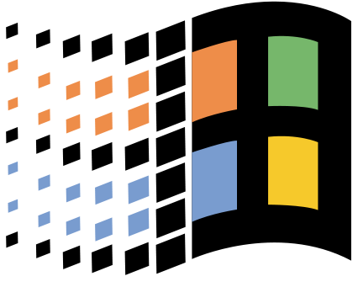

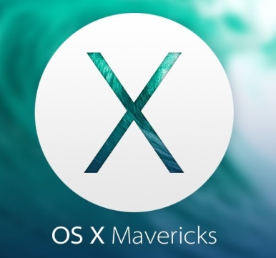
Development
Python 2.7.X
Pycharm
Linux, OSX, Windows
Git

Slide 4
What is Hashing
A way to encode a password to help protect it.
MD5 popcorn -> cf4ff726403b8a992fd43e09dd7b5717
SHA-256 popcorn -> 951e689364c979cc3aa17e6b0022ce6e4d0e3200d1c22dd68492c172241e0623

Slide 5
Hashing Algorithms
SHA-224, SHA-256, SHA-512, SHA-1, and MD5

Slide 6
Ways To Crack
Single User
Network Mode
Brute Force
Dictionary
Rainbow Table

Slide 7
Brute Force
Systematically checking all possible keys until the correct one is found.
Worst case this would transverse the entire search space.
Slowest but will always find the solution if given enough time.

Slide 8
Dictionary Attack
Uses a prebuilt list of possible keys
Attack succeeds because many people choose a password that based on a word and 7 characters of fewer
Dictionaries are compiled from leaked or cracked password lists.
This is why passwords should be new and not reused.

Slide 9
Rainbow Table
Ideally, we would store all possible hash/key combinations.
Storage is the problem.
Rainbow tables are a solution.
Reduce storage needs at the cost of computational complexity.
Storage can still be immense.
Time to crack is far faster than other methods.

Slide 10
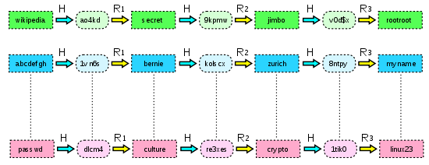
Rainbow Table

Slide 11
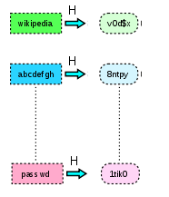
Rainbow Table

Slide 12
Single vs Networking
Single user mode only uses one computers power to crack a password. All cracking modes are available
Networking mode allows many nodes to connect to a host to increase power through parallelization. All cracking modes are available

Slide 13
GUI Demo

Slide 14
Why Python

Slide 15
Challenges

Slide 16
Other Products

Slide 17
Motivations

Slide 18
Future Plans

Slide 19
Questions?

